Slide 1
Digital Marketing Overview
Definition
What is digital marketing?
“Digital marketing” is the process of building and maintaining customer relationships through online activities to generate sales and/or capture customers that are searching on the Internet for answers.
Internet marketing, or online marketing, refers to the promotion of goods and services on the internet. The online world acts as a medium to communicate messages that a business drafts for its audience. Online marketing is also synonymous with online advertising.
Plain English: Getting found online

Slide 2
Some more
“Digital marketing is the practice of promoting products and services using digital distribution channels to reach consumers in a timely, relevant, personal and cost-effective manner” (Reitzin, 2007)
Digital Marketing is the process of MARKETING of Products and services by using internet and digital devices like computers, tablets, mobile phones etc

Slide 3

Digital Marketing Overview
(brainstorm)
Why are people going online?

Slide 4
Digital Marketing Overview
Why are people going online?
For information on a new product, service or location
With the constant growth of the web, and more people getting connected every day, digital marketing has become a necessity for many organizations. This also includes small businesses that want to trade online and make a name for themselves on the web.
The web is crowded with information. If you have a website, how can these people reach you? What are the benefits of digital marketing?

Slide 5
What is Marketing?
Marketing is a process of identifying customers’ needs and satisfying those needs by delivering the products or services by creating the value for customers as well as for the business
Identification of needs
Satisfaction of needs
Delivering Products or Services
Creating value for customers
Creating value for customers

Slide 6
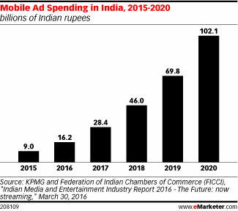
Digital Ad Spend Risen
The trend of digital marketing is working on the number of clicks and the ad being viewed, by the audience.
The digital ads allow the businesses to bring in the right audience and target the correct set of audience

Slide 7
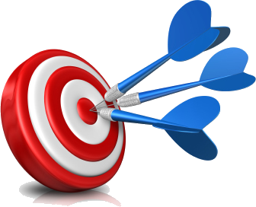
Digital Marketing Overview
What are the benefits of digital marketing?
Over traditional marketing *
Puts the consumer in control
Provides convenience
Drives brand loyalty
Reduces the selling cycle
Builds your brand
It is measurable
It is cost effective

Slide 8

Digital Marketing Overview
Digital marketing objectives
One way to make sure you are found on the web is with an optimized digital marketing strategy. Most digital marketing strategies and campaigns have 5 objectives:
Reach the right audience
Engage with your audience
Motivate your audience to take action
Ensure efficient spending on your campaign
Maximize return on investment (ROI)

Slide 9
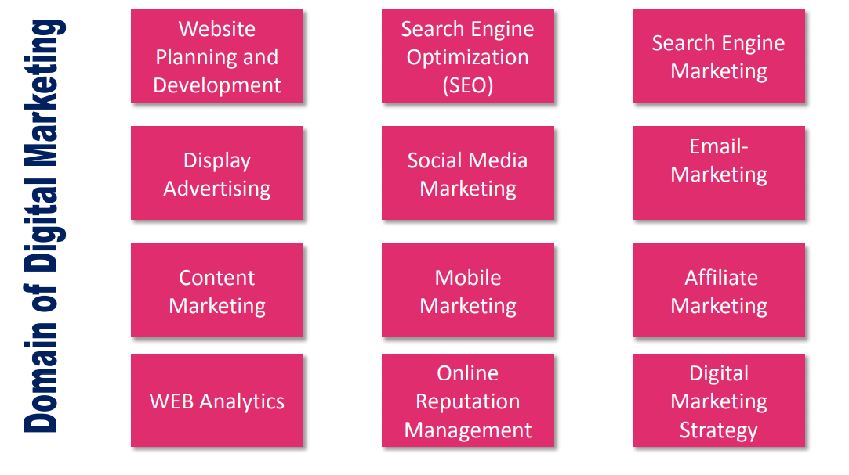
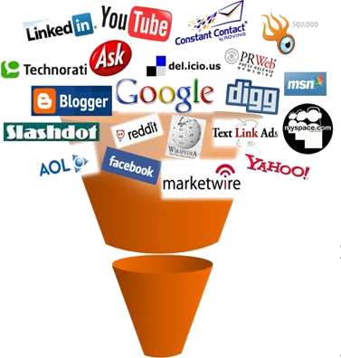
Digital Marketing Overview
What does digital marketing consist of?

